Slide 1

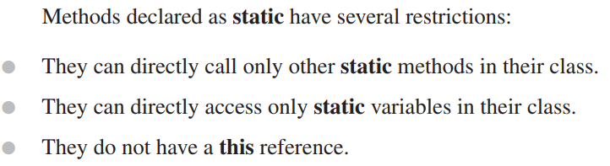
Methods and Classes

Slide 2
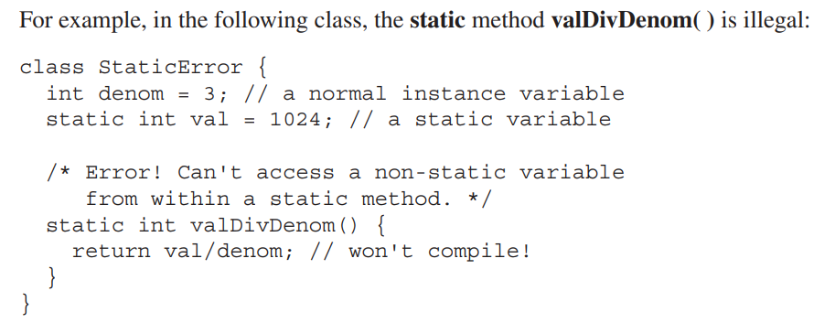
Methods and Classes

Slide 3

Methods and Classes
Sometimes a class will require some type of initialization before it is ready to create objects.
For example, it might need to establish a connection to a remote site. It also might need to initialize certain static variables before any of the class’ static methods are used.
To handle these types of situations, Java allows you to declare a static block.

Slide 4
Methods and Classes
A static block is executed when the class is first loaded.
Thus, it is executed before the class can be used for any other purpose.
Here is an example of a static block:

Slide 5
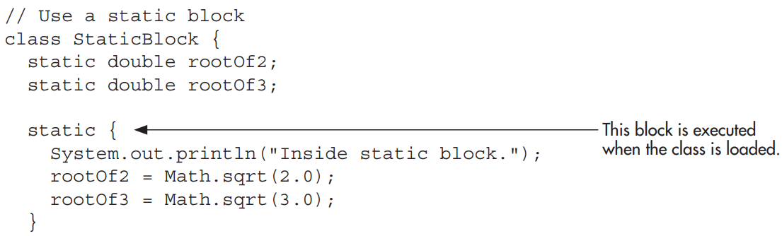
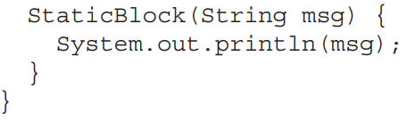
Methods and Classes

Slide 6
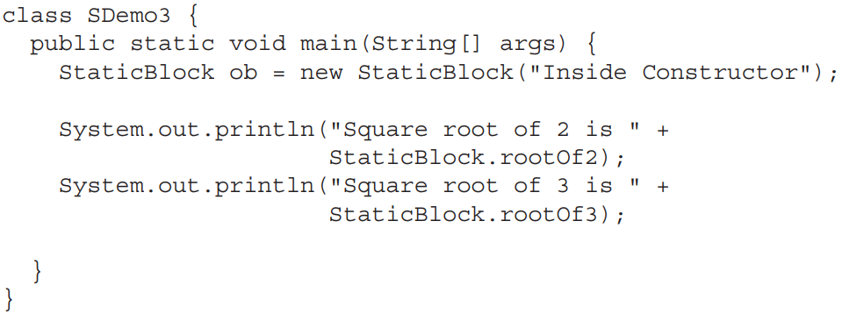
Methods and Classes

Slide 7
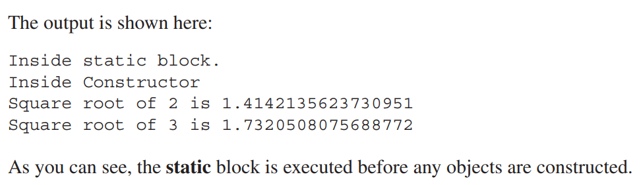
Methods and Classes

Slide 8
Methods and Classes
In Java, you can define a nested class. This is a class that is declared within another class.
Nested classes play an important role in many real-world programs.
A nested class does not exist independently of its enclosing class. Thus, the scope of a nested class is bounded by its outer class.

Slide 9
Methods and Classes
A nested class that is declared directly within its enclosing class scope is a member of its enclosing class.
It is also possible to declare a nested class that is local to a block.

Slide 10
Methods and Classes
There are two general types of nested classes: those that are preceded by the static modifier and those that are not.
The only type that we are concerned about in this topic is the non-static variety.
This type of nested class is also called an inner class.
It has access to all of the variables and methods of its outer class and may refer to them directly in the same way that other non-static members of the outer class.

Slide 11
Methods and Classes
Sometimes an inner class is used to provide a set of services that is needed only by its enclosing class.
Here is an example that uses an inner class to compute various values for its enclosing class:

Slide 12
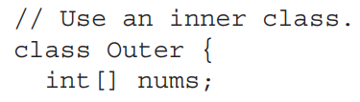
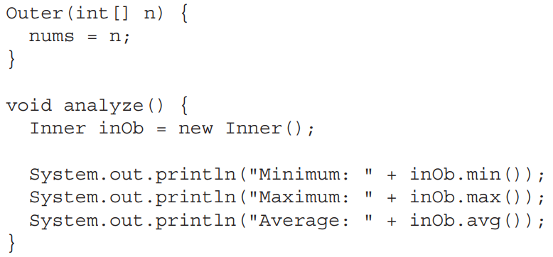
Methods and Classes

Slide 13
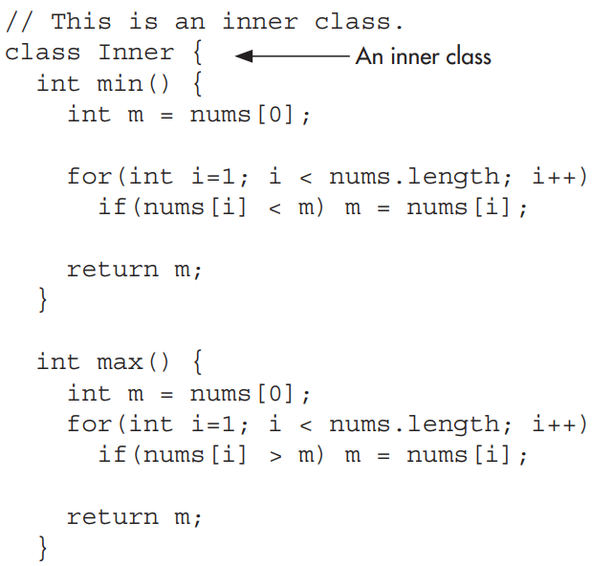
Methods and Classes

Slide 14
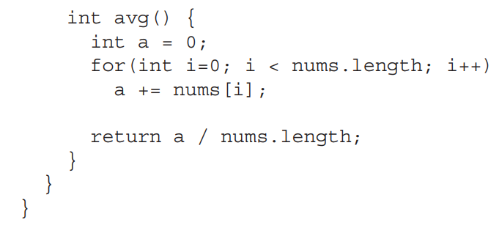
Methods and Classes
// end inner class
// end outer class

Slide 15
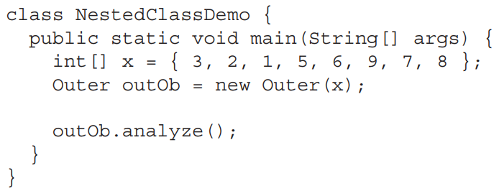
Methods and Classes

Slide 16
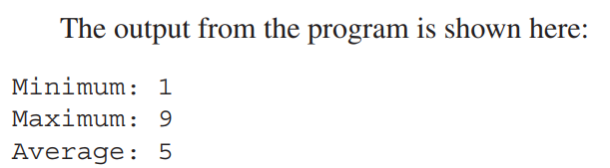
Methods and Classes

Slide 17
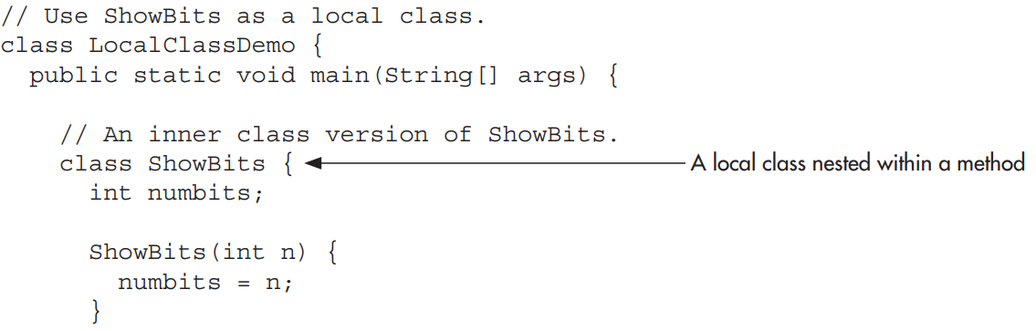
Methods and Classes
It is possible to nest a class within a block scope. Doing so simply creates a localized class that is not known outside its block.

Slide 18
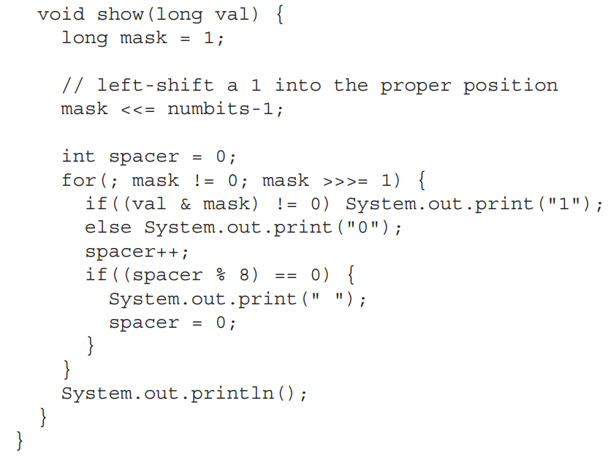
Methods and Classes
// end local class

Slide 19

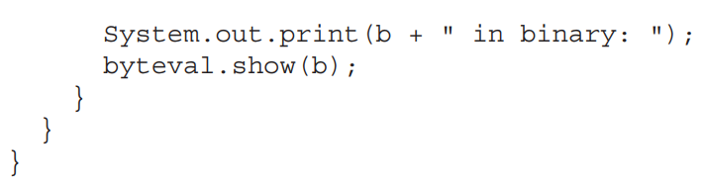
Methods and Classes
// end main method
// end main class

Slide 20
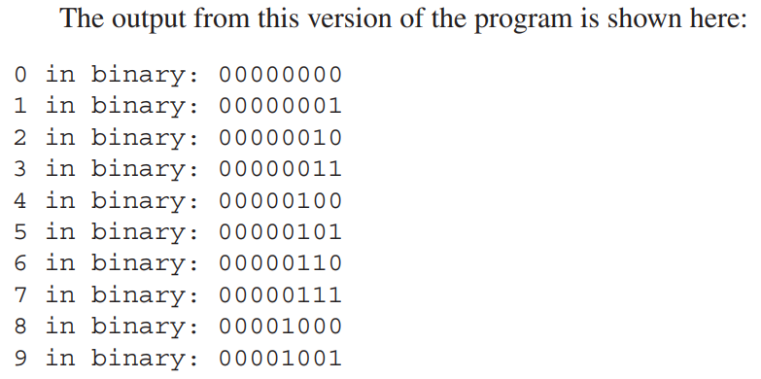
Methods and Classes

